Slide 1
Introduction to Bioinformatics

Slide 2

4. Nussinov algorithm (or base pair maximization)
Foundation of RNA structure prediction
Attempts to maximize RNA base pairs
Similar to DP algorithms we have already studied
Does not predict pseudoknots
Ruth Nussinov, Professor of Bioinformatics,
Dept. of Human Genetics,
Tel Aviv University, Isreal

Slide 3
Basic idea
Given an RNA sequence of some length
If there are two complimentary bases, score is 1
Else, score is 0
We find the maximum number of base pairs that are possible in a given sequence

Slide 4
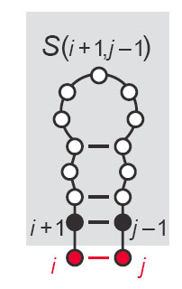
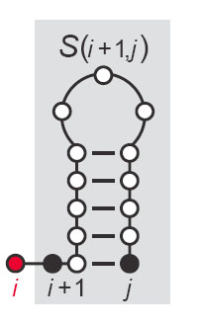
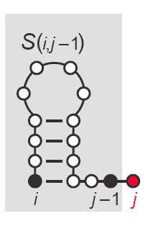
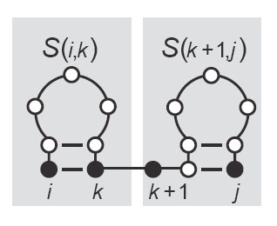
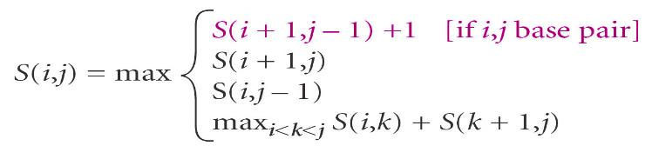
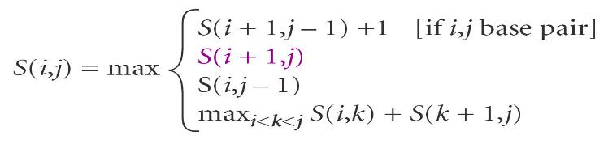
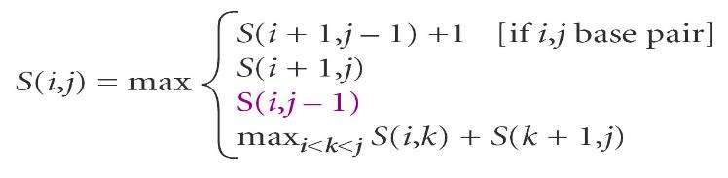
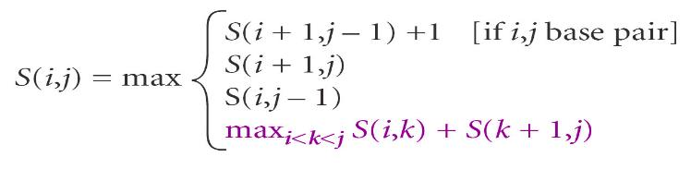
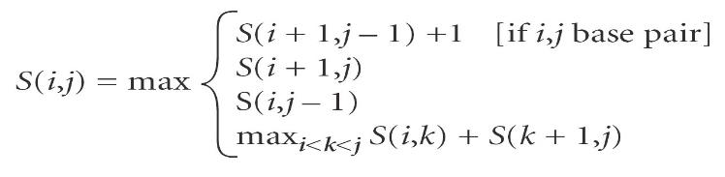
Example
S(i,j) is the folding of the subsequence of the RNA strand from index i to index j which results in the highest number of base pairs
Unmatched at i
Bifurcation
Umatched at j
Base pair at i and j
Images – Sean Eddy
Notes:
Slide not for exam
We pick the maximum score from 4 possible scores
For this class, we ignore Bifurcation that actually joins two secondary structure elements

Slide 5
Alignment Method
Alignment Method
Align RNA strand to itself
Score increases for feasible base pairs
Do not consider G/U for this example
Each score independent of overall structure
Bifurcation adds extra dimension (don’t worry about this)

Slide 6
Algorithm
Initialize first two diagonals with zeros (identical bases do not pair)
Then Start filling the diagonals
j
i
Image Source: Durbin et al. (2002) “Biological Sequence Analysis”

Slide 7
Algorithm
Score = 1, if bases are complimentary
Score = 0, if bases do not pair
j
i
Image Source: Durbin et al. (2002) “Biological Sequence Analysis”

Slide 8
Algorithm
We pick maximum score from three directions,
Bottom
Left
Diagonal
j
i
Image Source: Durbin et al. (2002) “Biological Sequence Analysis”

Slide 9
Algorithm
We pick maximum score from three directions,
Bottom is 1
j
i
Image Source: Durbin et al. (2002) “Biological Sequence Analysis”

Slide 10
Algorithm
We pick maximum score from three directions,
Left is 0
j
i
Image Source: Durbin et al. (2002) “Biological Sequence Analysis”

Slide 11
Algorithm
We pick maximum score from three directions,
Diagonal is 0
Check if ‘A’ and ‘U’ pair or not? They do!
Add +1 into whatever the value is in diagonal
j
i
Image Source: Durbin et al. (2002) “Biological Sequence Analysis”

Slide 12
Algorithm
j
i
Image Source: Durbin et al. (2002) “Biological Sequence Analysis”

Slide 13
Completed Matrix
Final value of 3 implies there are a maximum of 3 base pairs in the final structure
We do the traceback by starting from the maximum value and going down until we find the minimum value
j
i
Image Source: Durbin et al. (2002) “Biological Sequence Analysis”

Slide 14
Retrieving the Structure
Traceback path is highlighted (one of many that could be taken)
Start from the maximum value and go down until you find the minimum value
j
i
Image Source: Durbin et al. (2002) “Biological Sequence Analysis”

Slide 15
Retrieving the Structure
PAIRS
(2,9)
STACK
(3,8)
CURRENT
(2,9)
G
C
G
j
i
Image Source: Durbin et al. (2002) “Biological Sequence Analysis”

Slide 16
Retrieving the Structure
PAIRS
(2,9)
(3,8)
STACK
(4,7)
CURRENT
(3,8)
G
C
G
C
G
j
i
Image Source: Durbin et al. (2002) “Biological Sequence Analysis”

Slide 17
Retrieving the Structure
PAIRS
(2,9)
(3,8)
(4,7)
STACK
(5,6)
CURRENT
(4,7)
A
U
G
C
G
C
G
j
i
Image Source: Durbin et al. (2002) “Biological Sequence Analysis”

Slide 18
Retrieving the Structure
A
PAIRS
(2,9)
(3,8)
(4,7)
STACK
(6,6)
CURRENT
(5,6)
A
U
G
C
G
C
G
j
i
Image Source: Durbin et al. (2002) “Biological Sequence Analysis”

Slide 19
Retrieving the Structure
A
A
PAIRS
(2,9)
(3,8)
(4,7)
STACK
-
CURRENT
(6,6)
A
U
G
C
G
C
G
j
i
Image Source: Durbin et al. (2002) “Biological Sequence Analysis”

Slide 20
Retrieving the Structure
A
A
A
U
G
C
G
C
G
j
i
Image Source: Durbin et al. (2002) “Biological Sequence Analysis”

Slide 21
Structure Representation
We can use bracket notation to represent RNA structures
S={(1,13), (2,12), (3,11), (4,10)}
U
C
A
U
G
C
G
U
A
A
U
G
A
U
C
U
C
U
A
G
G
A
U
C
G
C
1
2
3
4
5
6
7
8
9
10
11
12
13

Slide 22
Points to consider
RNA structure prediction remains a difficult problem to solve
We discussed 4 different approaches (there are many others) to solve RNA secondary structure elements,
Which approach do you think is the better of the lot?
Dot plot (visual)
Minimum free energy (closer to reality?)
Co-variance (bring evolution into the equation)
Base pair maximization (considers all possibilities)

Slide 24
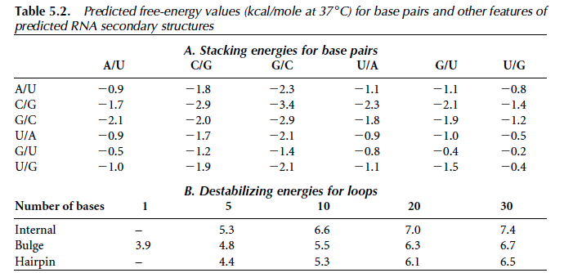

A
A
A
U
G
C
G
C
G

